Slide 1
OLIST STORE
E-Commerce Analysis

Slide 2
Project Timeline
PAY
Excel
01
8th to 14th August
Tableau
02
15th to 22nd August
PowerBI
03
23rd to 29th August
SQL
04
30th August to 5th September

Slide 3
Short Insights of Project
In our E-Commerce project, we focused on analyzing and visualizing key performance indicators (KPIs) across various tools like Excel, Tableau, Power BI, and SQL. Each module was used to address specific aspects of the data, such as sales trends, customer behavior, and product performance.
We solved different KPIs, including revenue, order stats, and customer segmentation, and combined the insights into an interactive dashboard that provided a comprehensive overview of the eCommerce store's performance.
This integrated approach allowed us to gain a deep understanding of the data and make informed decisions.
It's the closest planet to the Sun
Despite being red, Mars is a cold place
It's a gas giant and the biggest planet

Slide 4
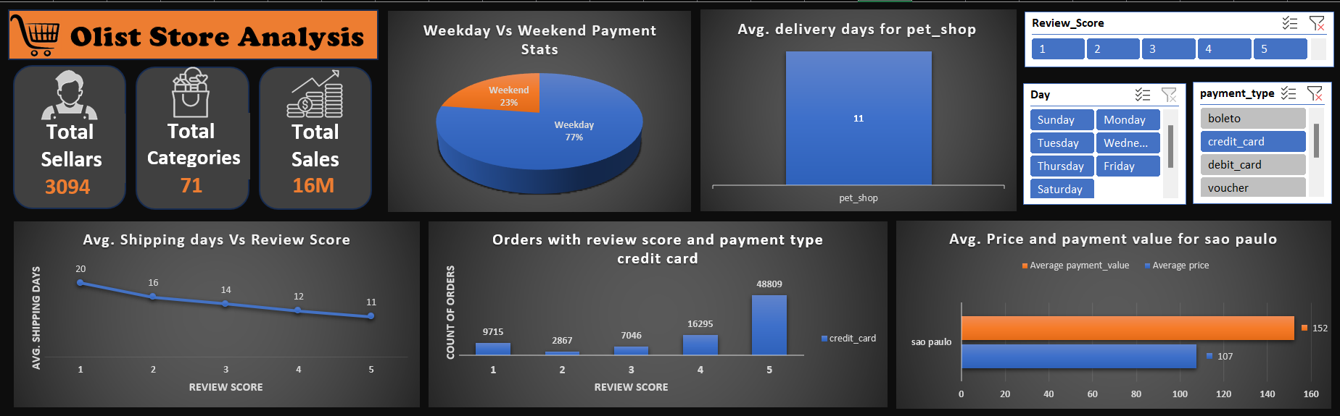
Excel Module

Slide 5
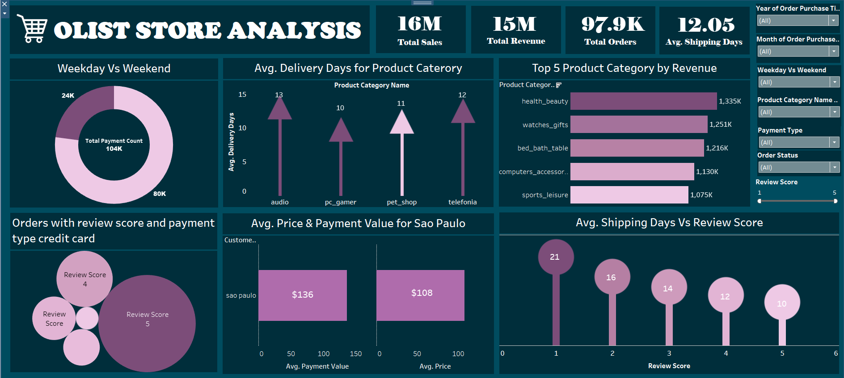
Tableau Module

Slide 6
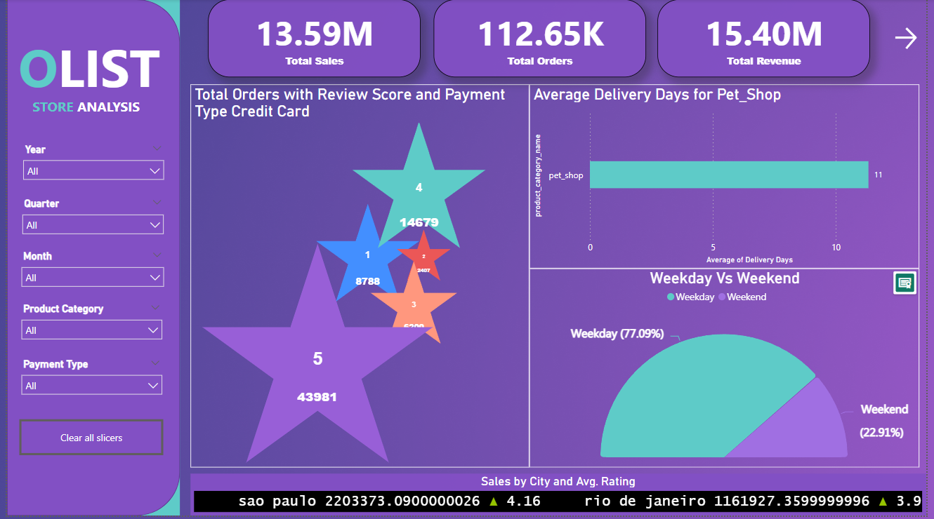
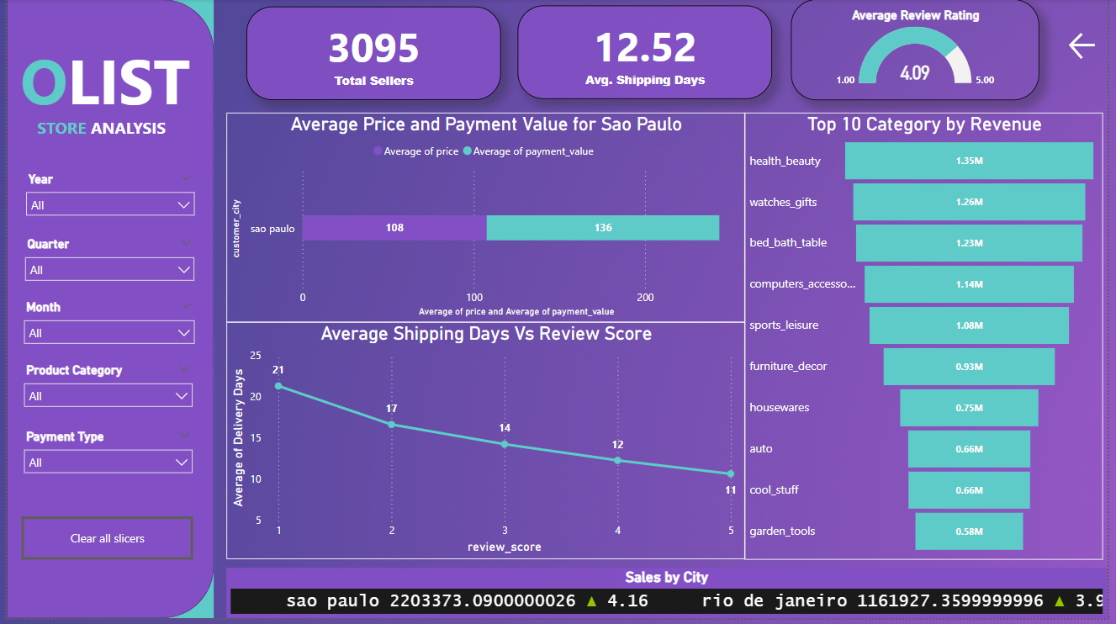
PowerBI Module

Slide 7
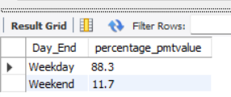
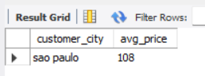
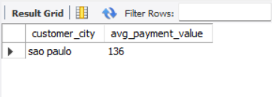
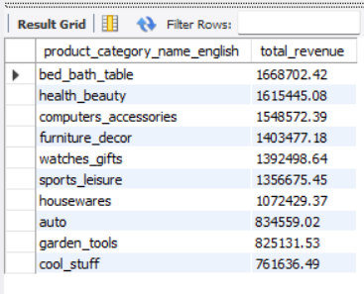
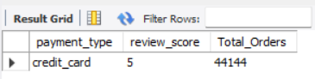
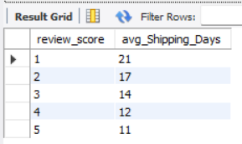

SQL Module
KPI 1
KPI 4
KPI 6
KPI 2
KPI 5
KPI 3

Slide 8
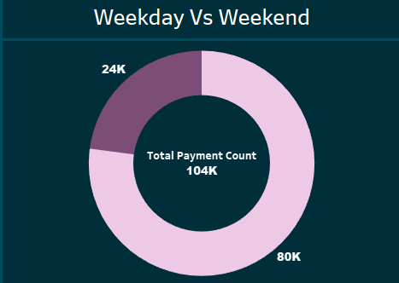
Key Point Indicators
Weekday Vs Weekend Payment Statistics
This KPI analyzes the payment trends by categorizing the order dates into weekdays and weekends. The goal is to understand whether customers spend more during the week or on weekends.
This analysis helps identify if promotional efforts should focus on weekends or weekdays. For example, higher sales on weekends could suggest a good time for weekend-only promotions.

Slide 9
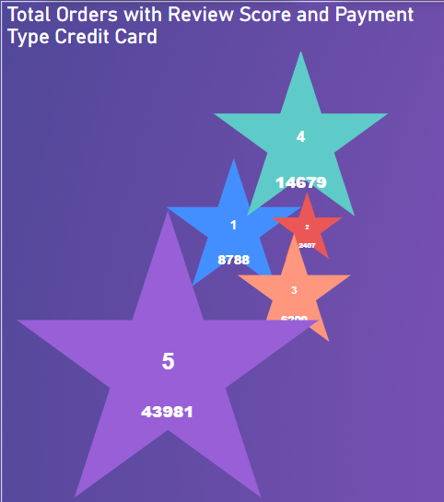
Number of Orders with review score 5 and payment type as credit card.
This KPI tracks the number of highly-rated orders (review score 5) that were paid for using a credit card. This metric provides insights into customer satisfaction and payment preferences.
A high number of such orders indicate a strong preference for credit card payments among satisfied customers, which might guide payment method promotions or loyalty programs.

Slide 10
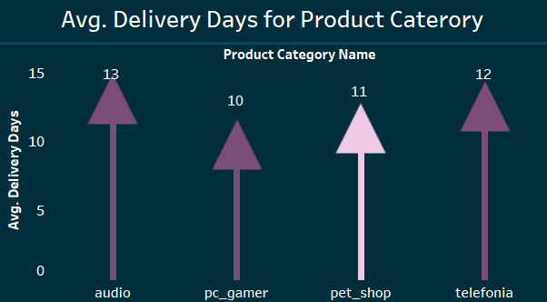
Average Number of Days Taken for Order Delivery for pet_shop Category
This KPI measures the average delivery time for products in the pet_shop category. It helps assess the efficiency of logistics for this specific category.
If the delivery time for pet_shop items is higher or lower than average, it indicates the need to optimize supply chain processes or adjust customer expectations.

Slide 11
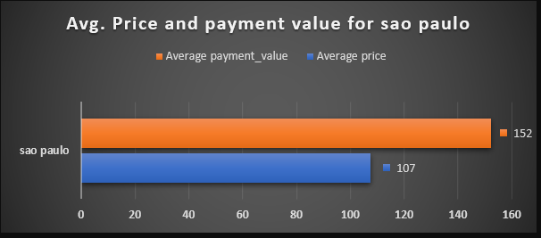
Average price and payment values from customers of sao paulo city
This KPI focuses on the average order price and payment values for customers located in São Paulo. It helps identify spending behavior specific to this geographic region.
Understanding spending patterns in São Paulo can help tailor marketing efforts or pricing strategies to this customer segment, especially if they have higher or lower average purchase values.

Slide 12
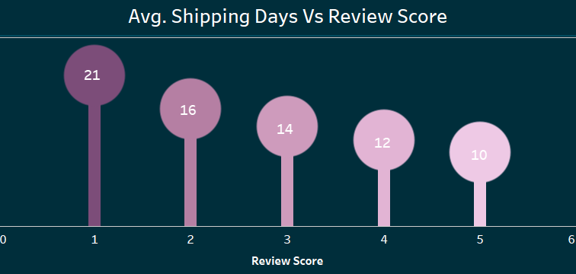
Relationship between shipping Vs review scores.
This KPI examines the correlation between the number of days taken to ship an order and the review score given by the customer. It seeks to understand if shipping speed influences customer satisfaction.
Longer shipping times correlate with lower review scores, improving delivery speeds could enhance customer satisfaction.

Slide 13
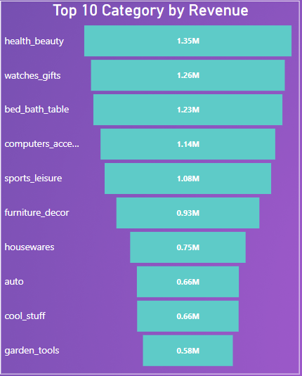
Top 10 product categories by revenue
Identified the top 10 product categories based on revenue. This KPI highlighted the highest-earning categories, guiding business decisions on inventory management, marketing focus, and resource allocation.

Slide 14
Challenges Faced
4
Visualization Challenges
Complex Data Relationships
2
1
Data Cleaning and Preparation
Data Aggregation and Calculation
3

Slide 15
CONCLUSION
The data analysis for the Olist store gives important insights into customer behavior and operational performance.
Key findings include variations in customer spending behavior by day of the week, preferences for payment methods among highly satisfied customers, and the need for improvements in delivery efficiency for specific product categories. Additionally, Identified top-performing product categories which help prioritize business strategies.
Overall, these insights provide a comprehensive understanding of customer behavior and operational performance, paving the way for more informed decision-making and strategic enhancements.

